Slide 1
Birds of the Field & Garden
Practice #1

Slide 2
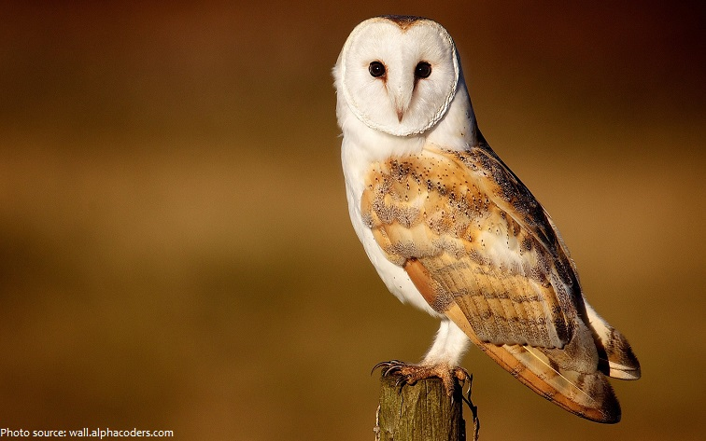


Slide 3
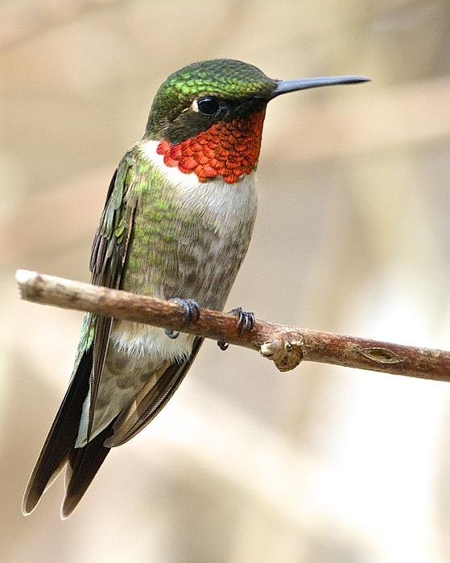
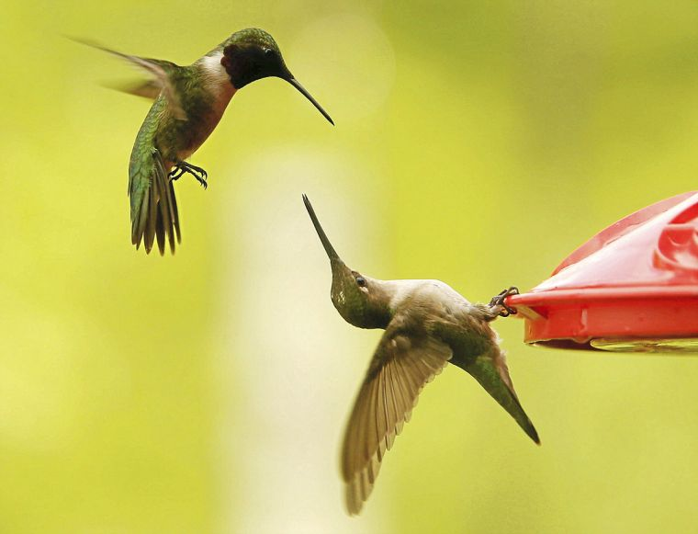

Slide 4
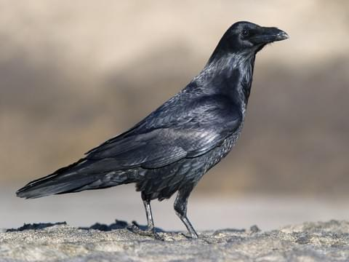

Slide 5
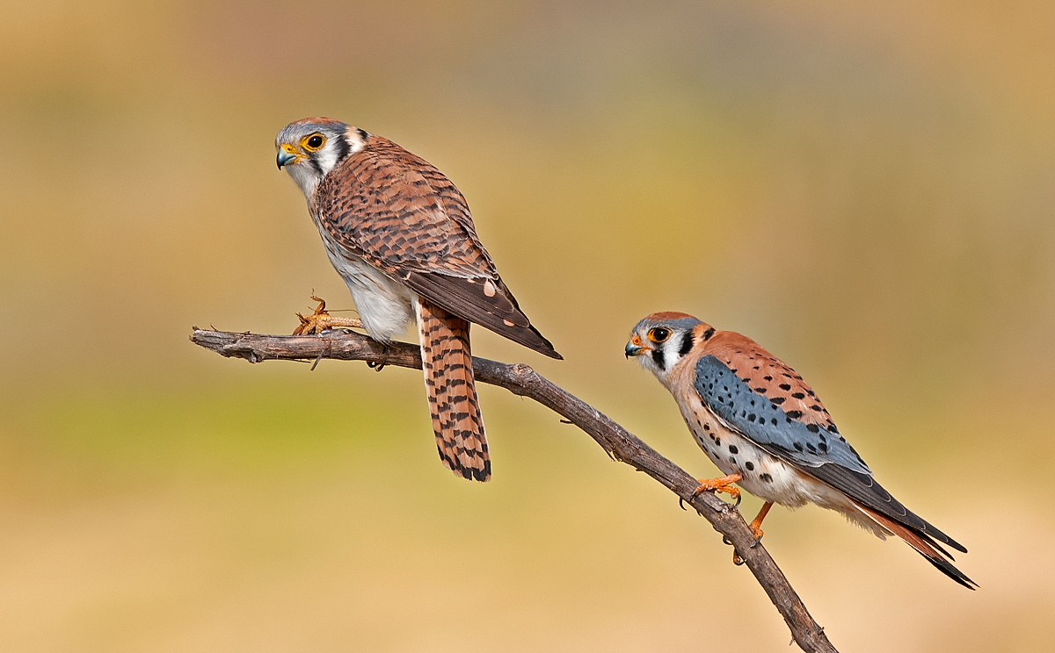

Slide 6
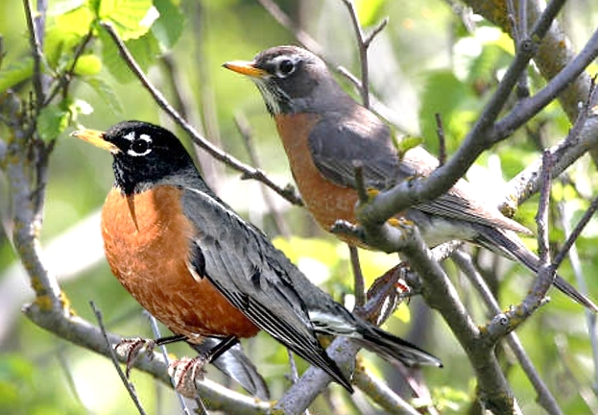

Slide 7
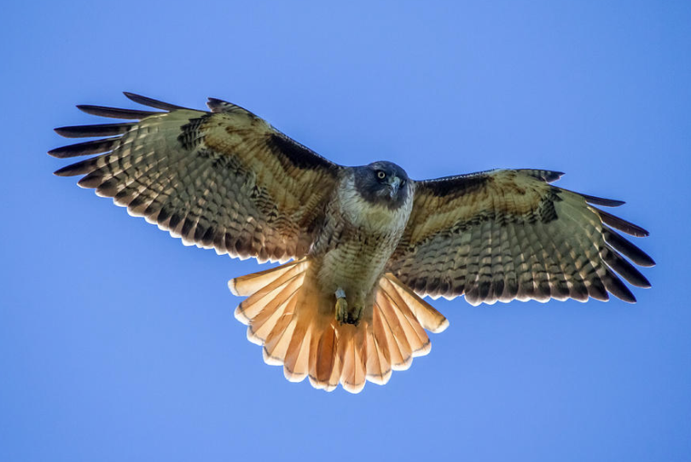
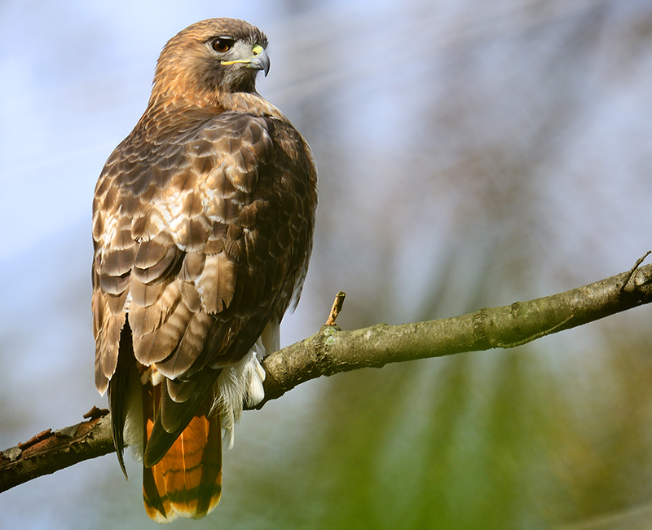

Slide 8
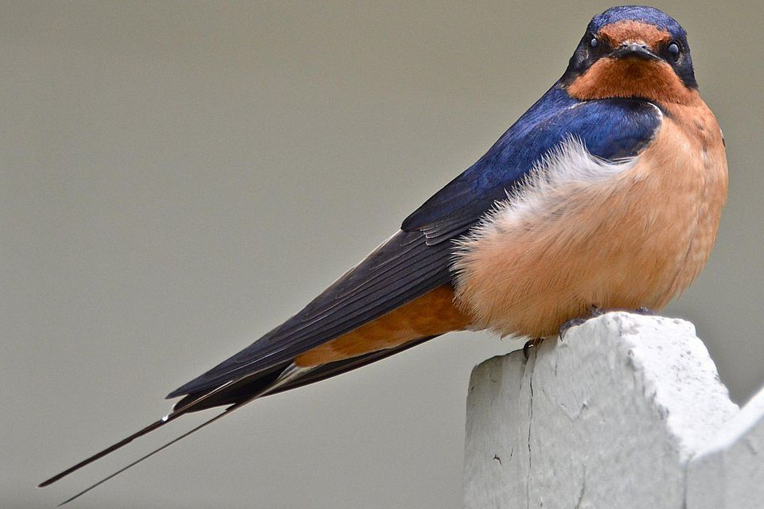

Slide 9
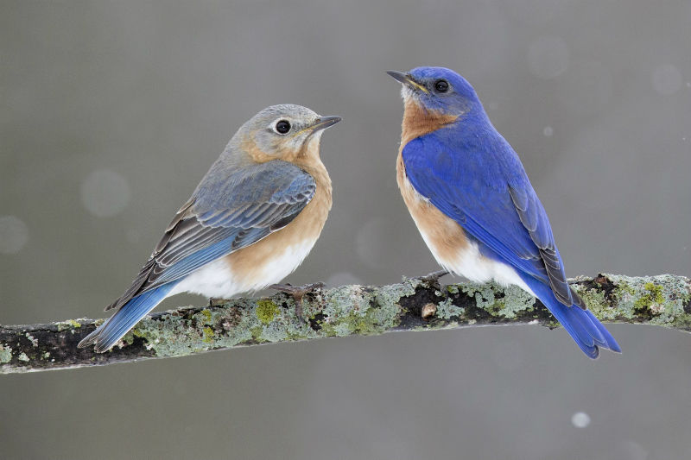

Slide 10
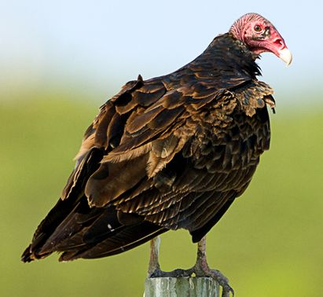

Slide 11
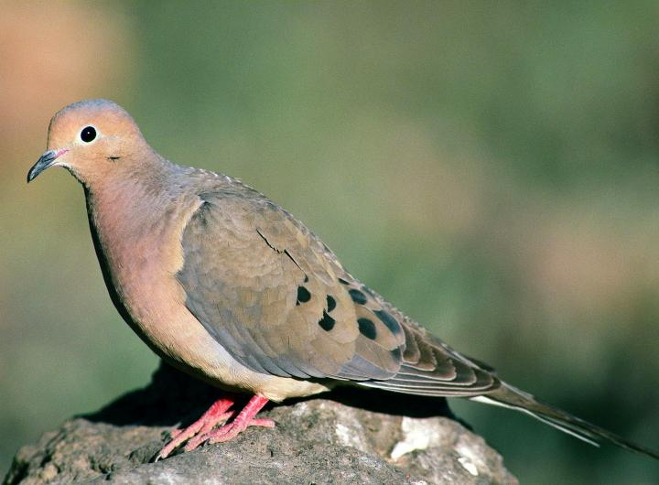

Slide 12
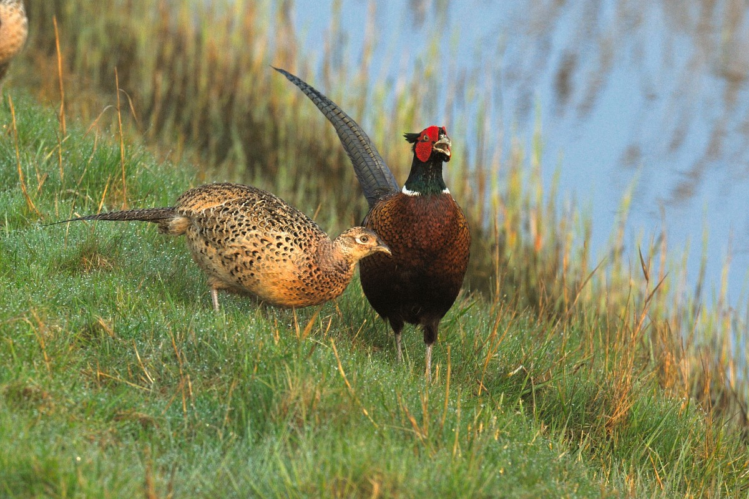

Slide 13
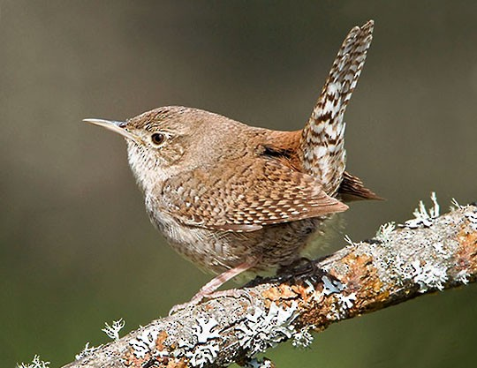
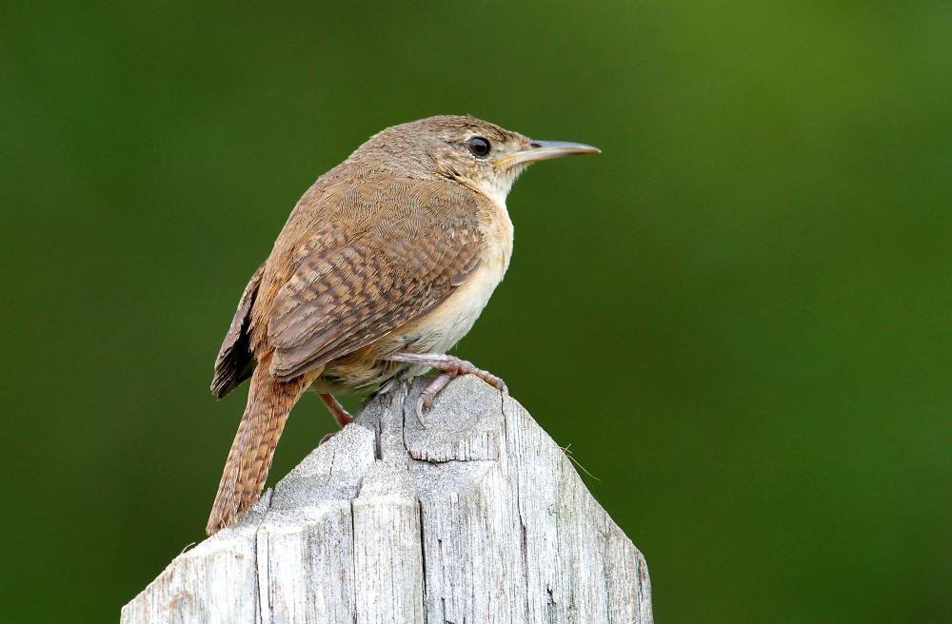

Slide 14
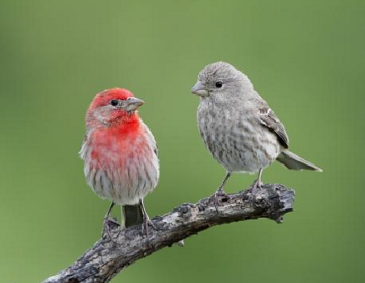

Slide 15
Answer Key
1) Title page – no species
2) Barn owl
3) Ruby-throated hummingbird
4) American crow
5) American kestrel
6) American robin
7) Red-tailed hawk
8) Barn swallow
9) Eastern bluebird
10) Turkey vulture
11) Mourning dove
12) Ring-necked pheasant
13) House wren
14) House finch

